Slide 1
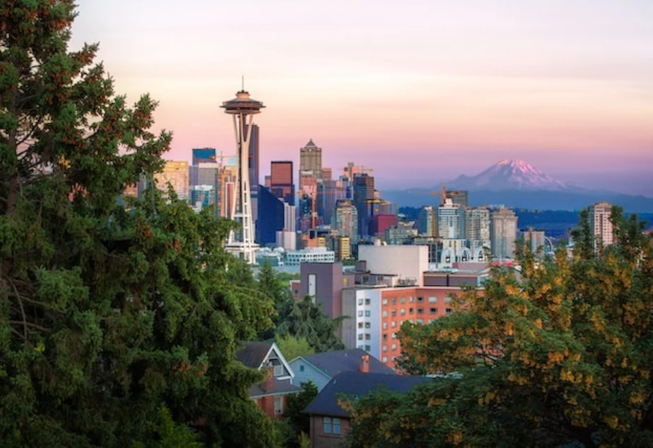
City Trees: Seattle
Condition Prediction Report
Brett Dickinson

Slide 2


Cities Need Trees Too
Improve air quality
Regulate surface temperature
Limit stormwater damage
Reduce noise pollution
Increased biodiversity
Notes:
U.S. News Story: https://www.usnews.com/news/cities/articles/2020-01-03/as-development-fells-trees-some-in-seattle-fight-to-save-the-citys-urban-forest
A city’s urban tree canopy brings all these benefits, but they are at risk from changing climates and urban sprawl.

Slide 3
Goals
Model to predict health of each tree
Project into the future, accounting for changing climates
Notes:
With a record of Seattle’s trees, we’ll pull in climate data and build a predictive model.
We’ll then update our features to make prediction in future years, with changing climates.

Slide 4



Data
Notes:
Dryad: Put together by university students – has over 5 million tree records across the U.S. Our project is filtered down to just Seattle (~160k trees)
https://datadryad.org/stash/dataset/doi:10.5061/dryad.2jm63xsrf
NOAA: Pulled in 15-year climate normal at the weather station detail.
https://www.ncei.noaa.gov/data/normals-annualseasonal/2006-2020/
CoCoRaHs: NOAA only had a few stations relevant to Seattle, so this gave much more granularity.
https://merbgai.cocorahs.org/ViewData/TotalPrecipSummary.aspx

Slide 5
Exploratory Data Analysis

Slide 6
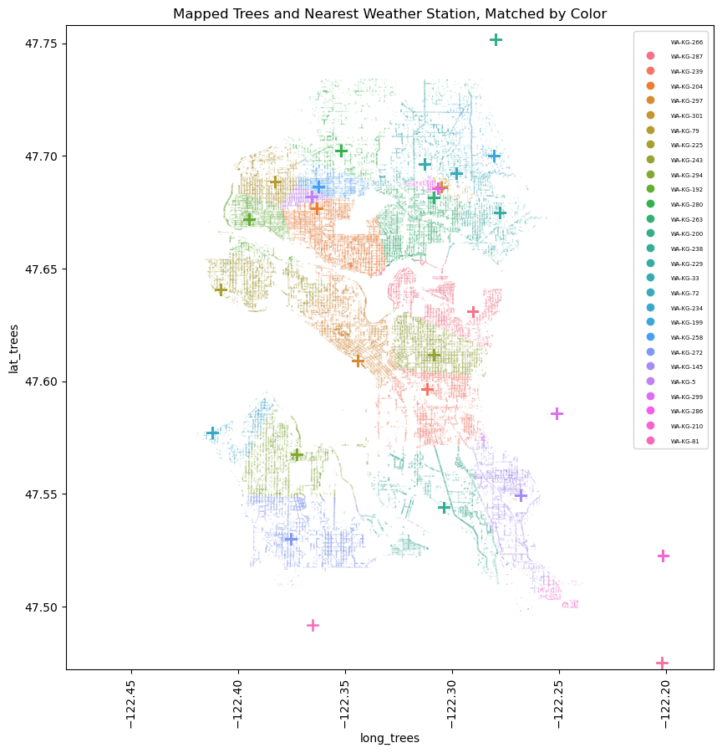
Cleaning climate data
Mapping each tree to nearest station
Notes:
CoCoRaHs is a crowd-source data platform for Washington rain and snowfall daily. There were a lot of missing values I had to work through.
Started by getting daily averages, applying an adjustment factor for the likelihood people would report amounts on days it does ran (rather than not), and imputing the missing values.
Created a function using the math python module, using this blog as reference:
https://medium.com/analytics-vidhya/finding-nearest-pair-of-latitude-and-longitude-match-using-python-ce50d62af546

Slide 7
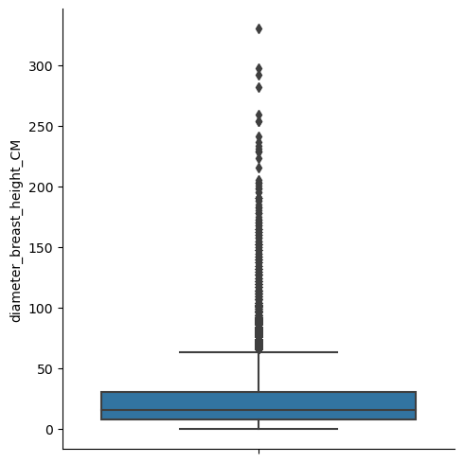
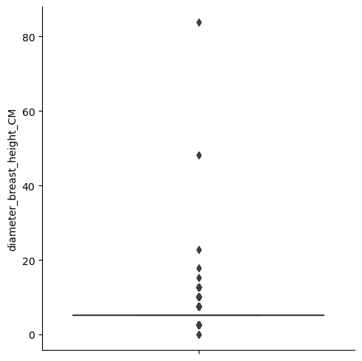
Dealing With Outliers - Diameter
All Trees (n=162,080)
Eddie’s Dogwood (n=408)
Notes:
Our tree diameter values proved to be difficult, as the majority of trees were similar size, but there were also many identical values – sort of a binning effect. Not surprising with so many records that the source would generalize a bit.
That made it difficult to truly say what was an outlier. In Eddie’s case, anything not 5cm was an outlier. So we addressed these differently. If there was an IQR greater than zero, I dropped values > 1.5x the IQR of the species. If the IQR=0, I dropped 3 standard deviations from the mean.

Slide 8
Preprocessing & Training

Slide 9
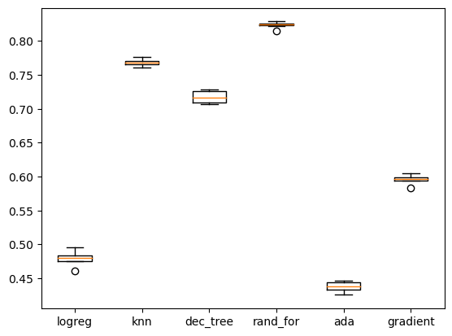
Which Model to Use?
Notes:
With so many classification models to choose from, I ran a loop of these five model types with cookie-cutter settings to see which gave the most promising results.
Random forest gave the highest results, so I put my focus on developing that model further. The others I checked were Logistic Regression, K Nearest-Neighbor, Decision Trees, and other ensemble methods ADA Boosting, and Gradient Boosting.

Slide 10
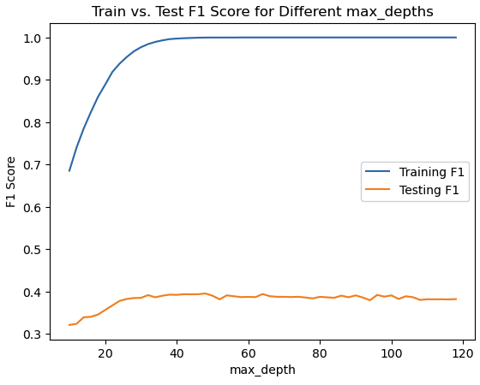
Model Tuning
Notes:
Used RandomizedSearchCV to run a range of hyperparameter values, and then GridSearchCV to fine-tune.
One of the key parameters was max_depth, by trimming this value (or not) it droves some of the largest swings in training performance as you can see on the graph above. I capped the max at 40 to try to not completely overfit and instead generalize a bit better to new data.
Still, at these various ranges you can see we don’t translate well to new data with larges decreases between training and testing results.

Slide 11
Final Model
 | Precision | Recall | F1-Score | Support
1.0 | 0.18 | 0.28 | 0.22 | 58
2.0 | 0.18 | 0.17 | 0.17 | 224
3.0 | 0.46 | 0.41 | 0.43 | 958
4.0 | 0.72 | 0.72 | 0.72 | 2,194
5.0 | 0.55 | 0.61 | 0.57 | 566
Accuracy |  |  | 0.59 | 4,000
Notes:
Our final model, when applied to the test set of 4,000 records had an overall accuracy of 59%. You can see it still struggled a bit with the imbalanced classes, despite our efforts using SMOTE.
This was using a sample of 20,000 records to build my model. But we have over 150k, would more be helpful?

Slide 12
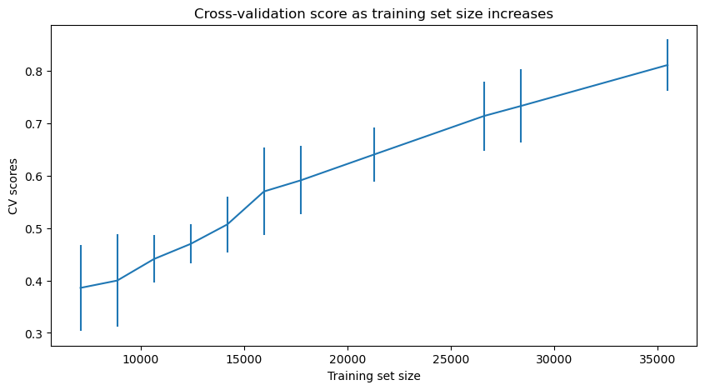
Learning Curve
Notes:
You can see more records would actually benefit my model’s predictive capabilities. But at the detriment to the processing power on my laptop. I stuck with 20,000 to continue with my modeling.
Psst. behind the scenes look -> I actually started with a 10,000 record sample, and then doubled it when I saw the initial learning curve.

Slide 13
Modeling

Slide 14
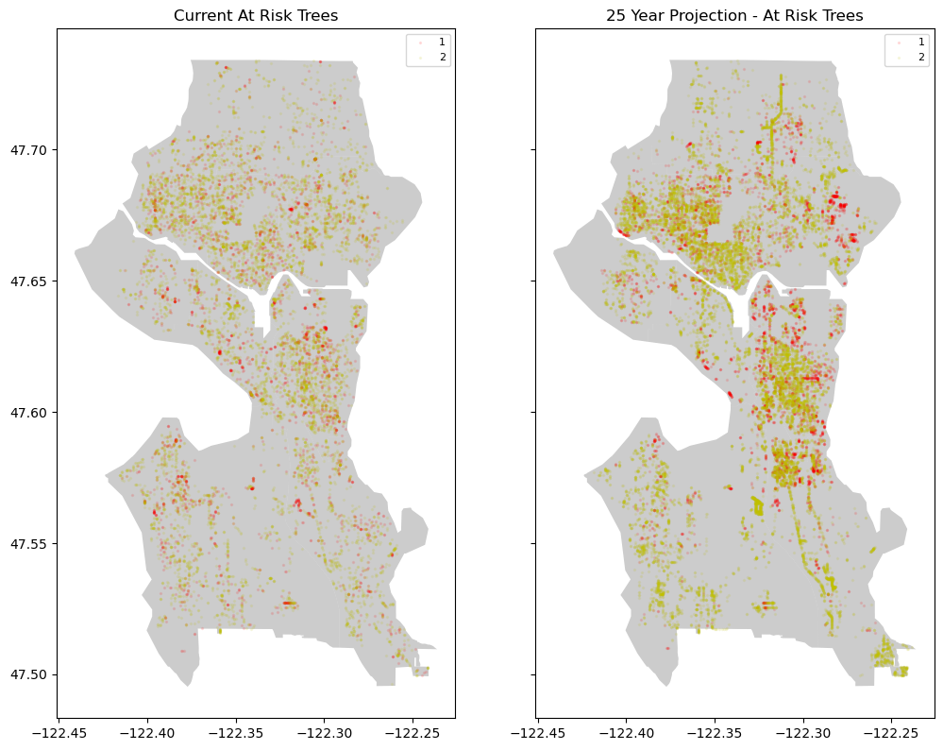
Model 1: At-Risk Trees
Current:
7.01%
25-Year Prediction: 13.73%
Notes:
My first model assumed stable climate factors, but a 25-year fast-forward. On the visualization, we can see the increasing red (dead/dying) and yellow (poor) quality density increasing.
Of course we know climate factors are not stable, so let’s shift our model to predict a changing climate.

Slide 15
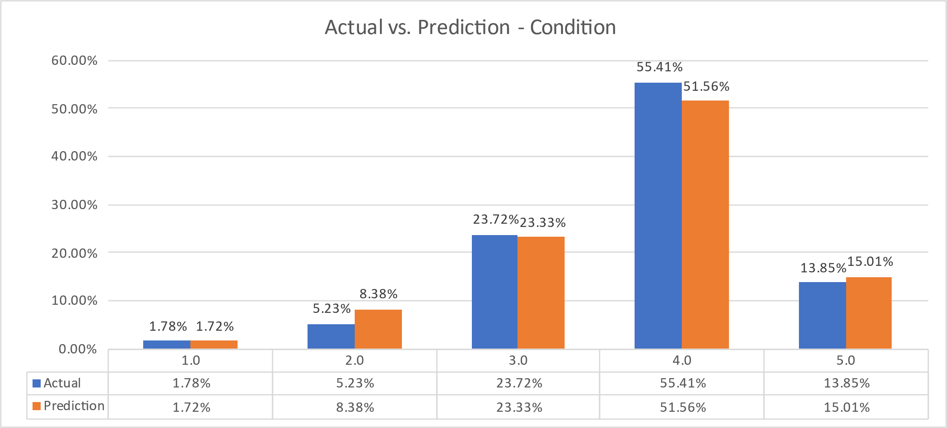
Model 2: Changing Climate
Notes:
Applying these climate change factors:
Average temperature: +5%
Total current year rainfall: +5%
Total current year snowfall: +2%
Average long-term average rainfall: +8%
These changes, along with 25-year fast forward, really show a shift out of the middle, but some increases in the 5.0 excellent category to go along with the larger increase in the 2.0 poor category.
But these are just totals, what really matters for city officials is which trees are the most at risk.

Slide 16
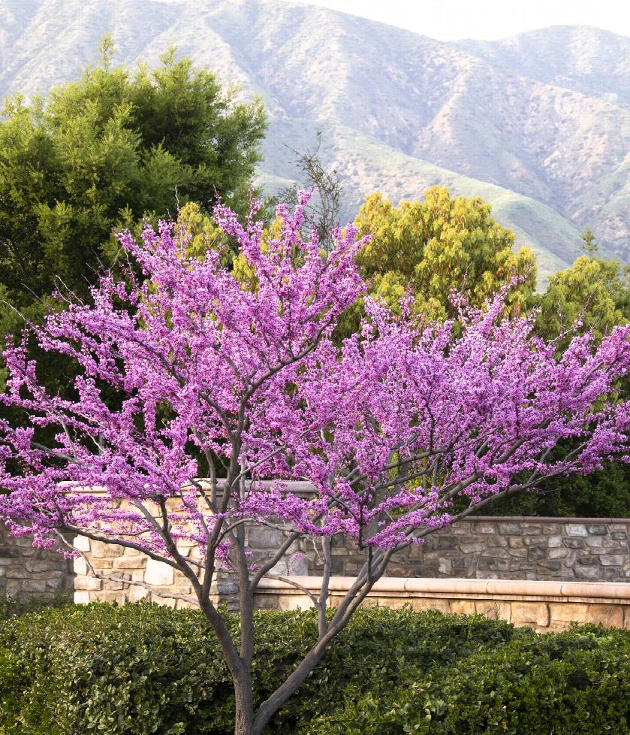
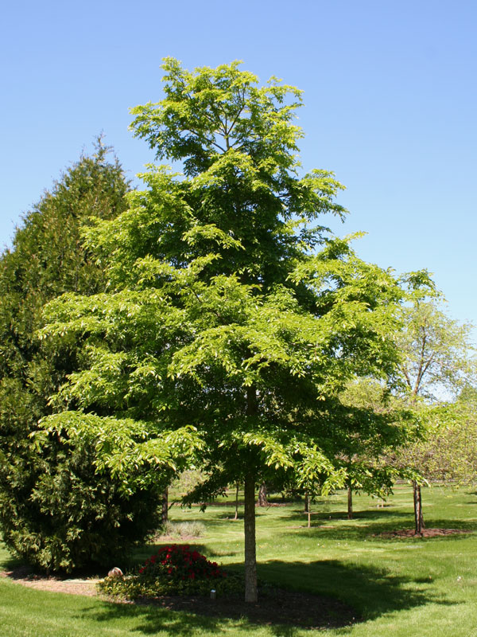
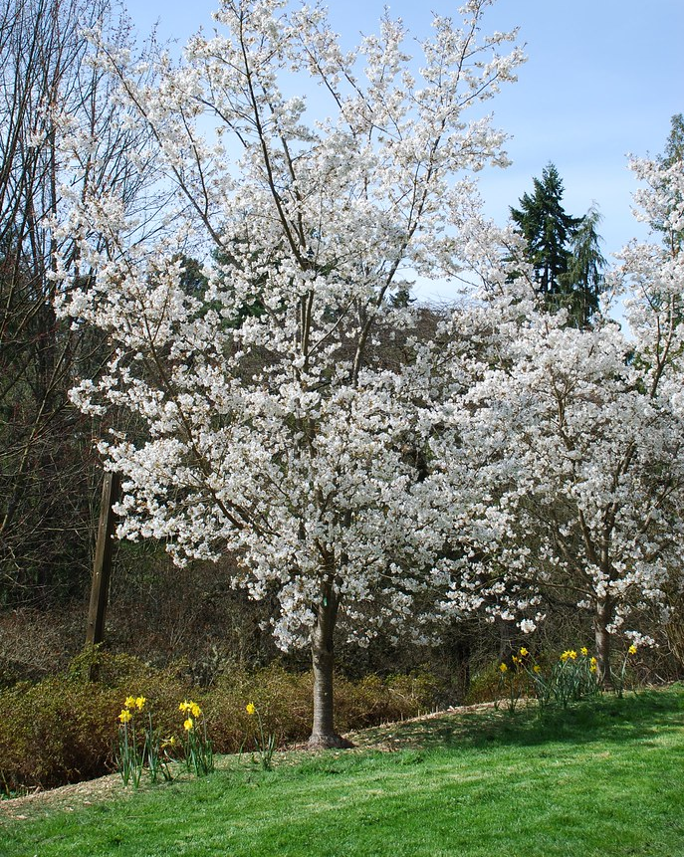
Model 3: In Loving Memory
Notes:
Out of our species with at least 50 records in Seattle, these 3 are predicted to have the biggest decline in health over the 25-year period.
-Cascade Snow Cherry (right) 2.5 avg decrease
-Accolade Elm (middle) 1.2 avg decrease
-Forest Pansy Redbud (left) 1.0 avg decrease

Slide 17
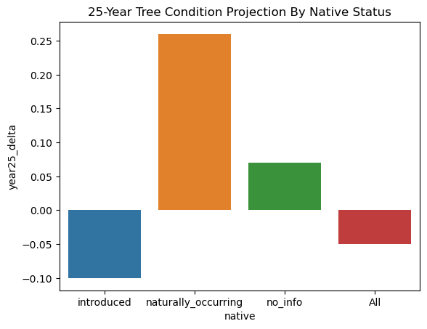
Native Status
Notes:
Introduced trees make up the majority of our total records (73%), but stand to be the most affected by the changing climate and years. This is important information for city planners and people looking to intervene on the health of Seattle’s trees.

Slide 18
Future Improvements
Richer climate data & projections
Geographic feature engineering
Annual updates
Notes:
This model would have benefited from more detailed climate data that doesn’t generalize so many trees into one weather station. Whether it be estimates for specific land areas taking into account the surroundings (i.e. roadways hotter than parks)
More geographic feature engineering that could create more detailed tree clusters (like what type of city features were close by (road, sidewalk, park, cable lines, etc.) or how many trees are clustered in a specific area. Things that were beyond my expertise.
Once you add those those beneficial features, annual progress and projection updates would be crucial to track the success rate of interventions.

